Slide 1
Data Science Salaries Analysis
Group 6: Adrian Sandoval, Louis Ferrante, Ryan Woyce, Libnis Sanchez, and Emily Shewcraft

Slide 2
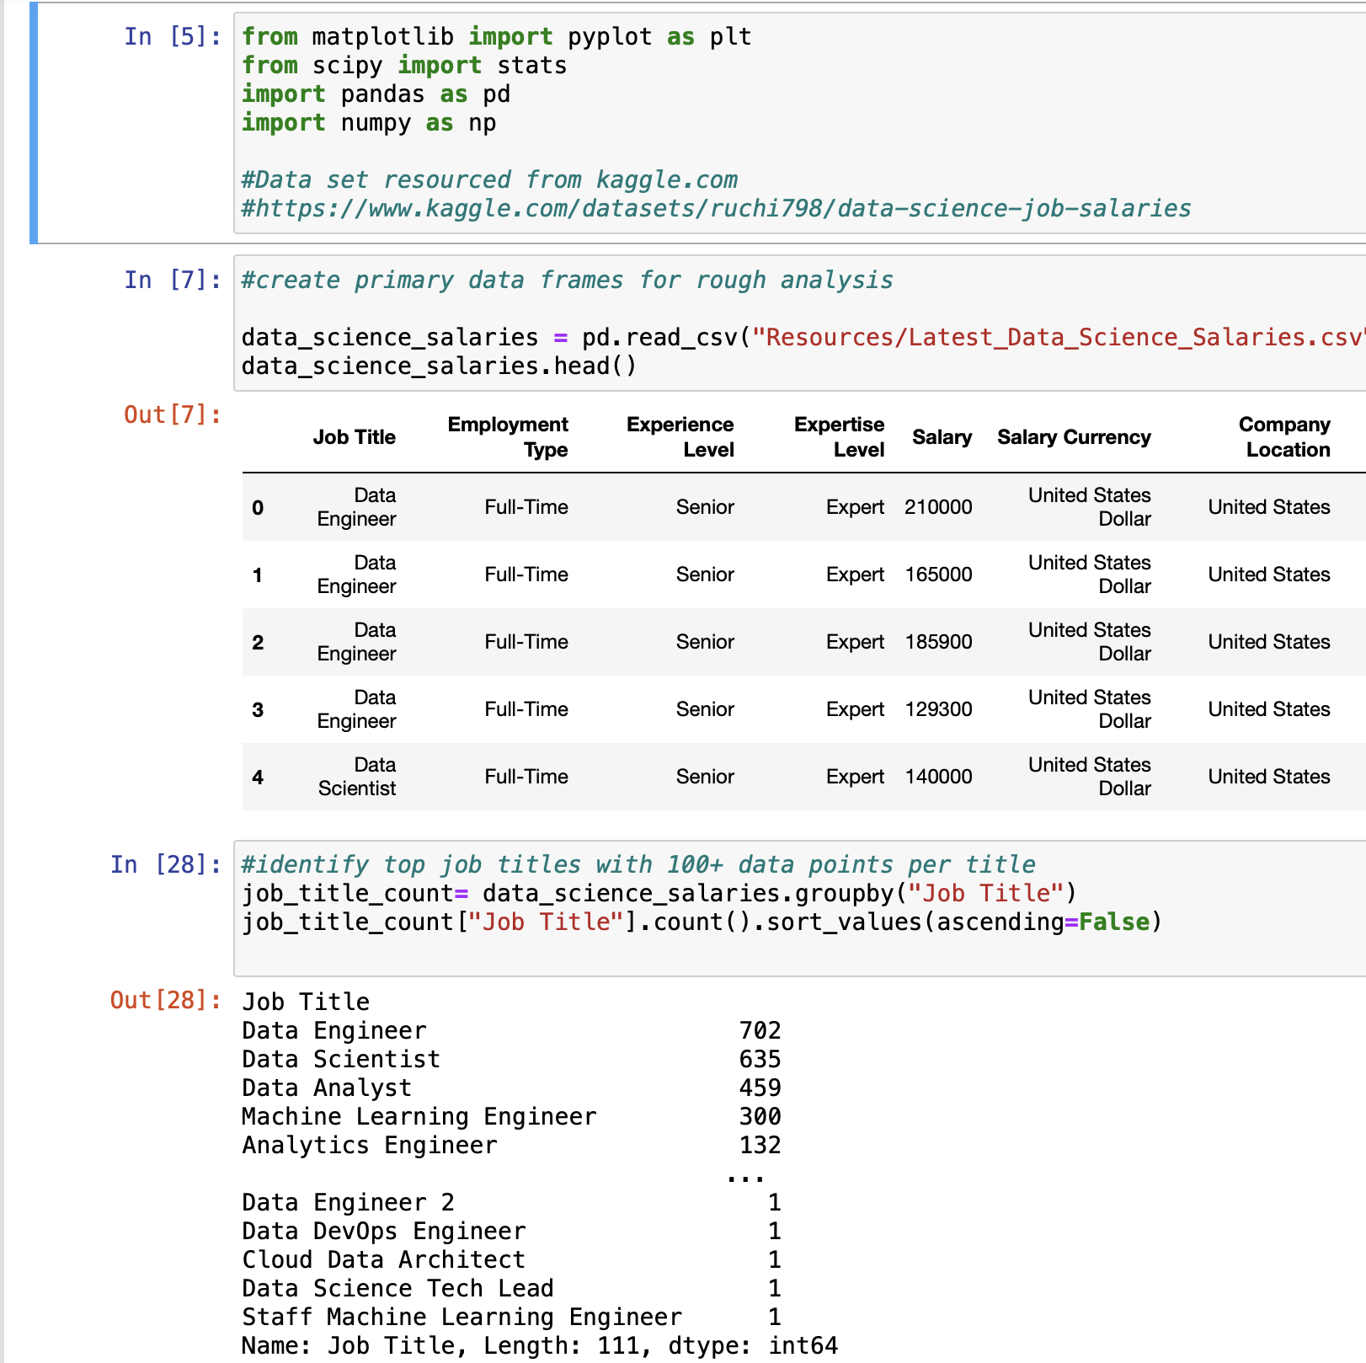
Jupyter Notebook Cleaning
Data Sourced via Kaggle.
https://www.kaggle.com/datasets/ruchi798/data-science-job-salaries
Data set included 111 job title samples with 3300 employees surveyed.
Data cleaning focused on top 5 job titles with 100 or more employees.
Explored job titles vs experience levels in order to gain best insights on next steps.
Final data cleaning resulted in moving forward with job titles with all experience levels included to better understand salary trends.

Slide 3
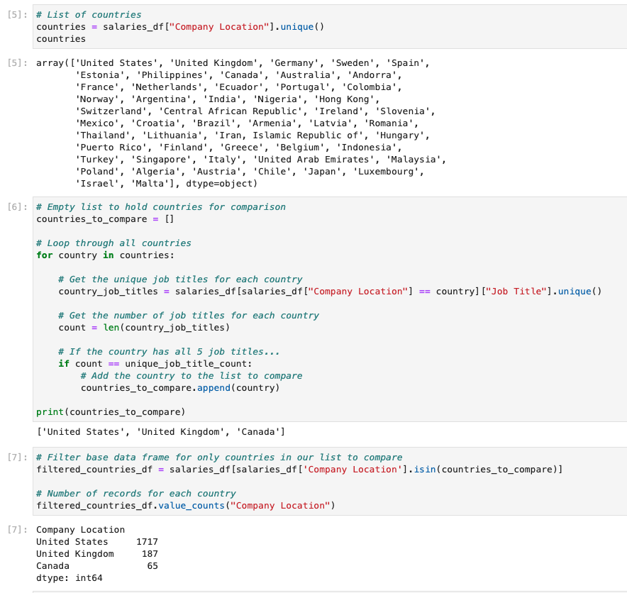
Median Income by Country for top Job Titles
- Looked at median income for 5 most common positions.
- Decided to narrow down our analysis to include only countries that had all 5.

Slide 4
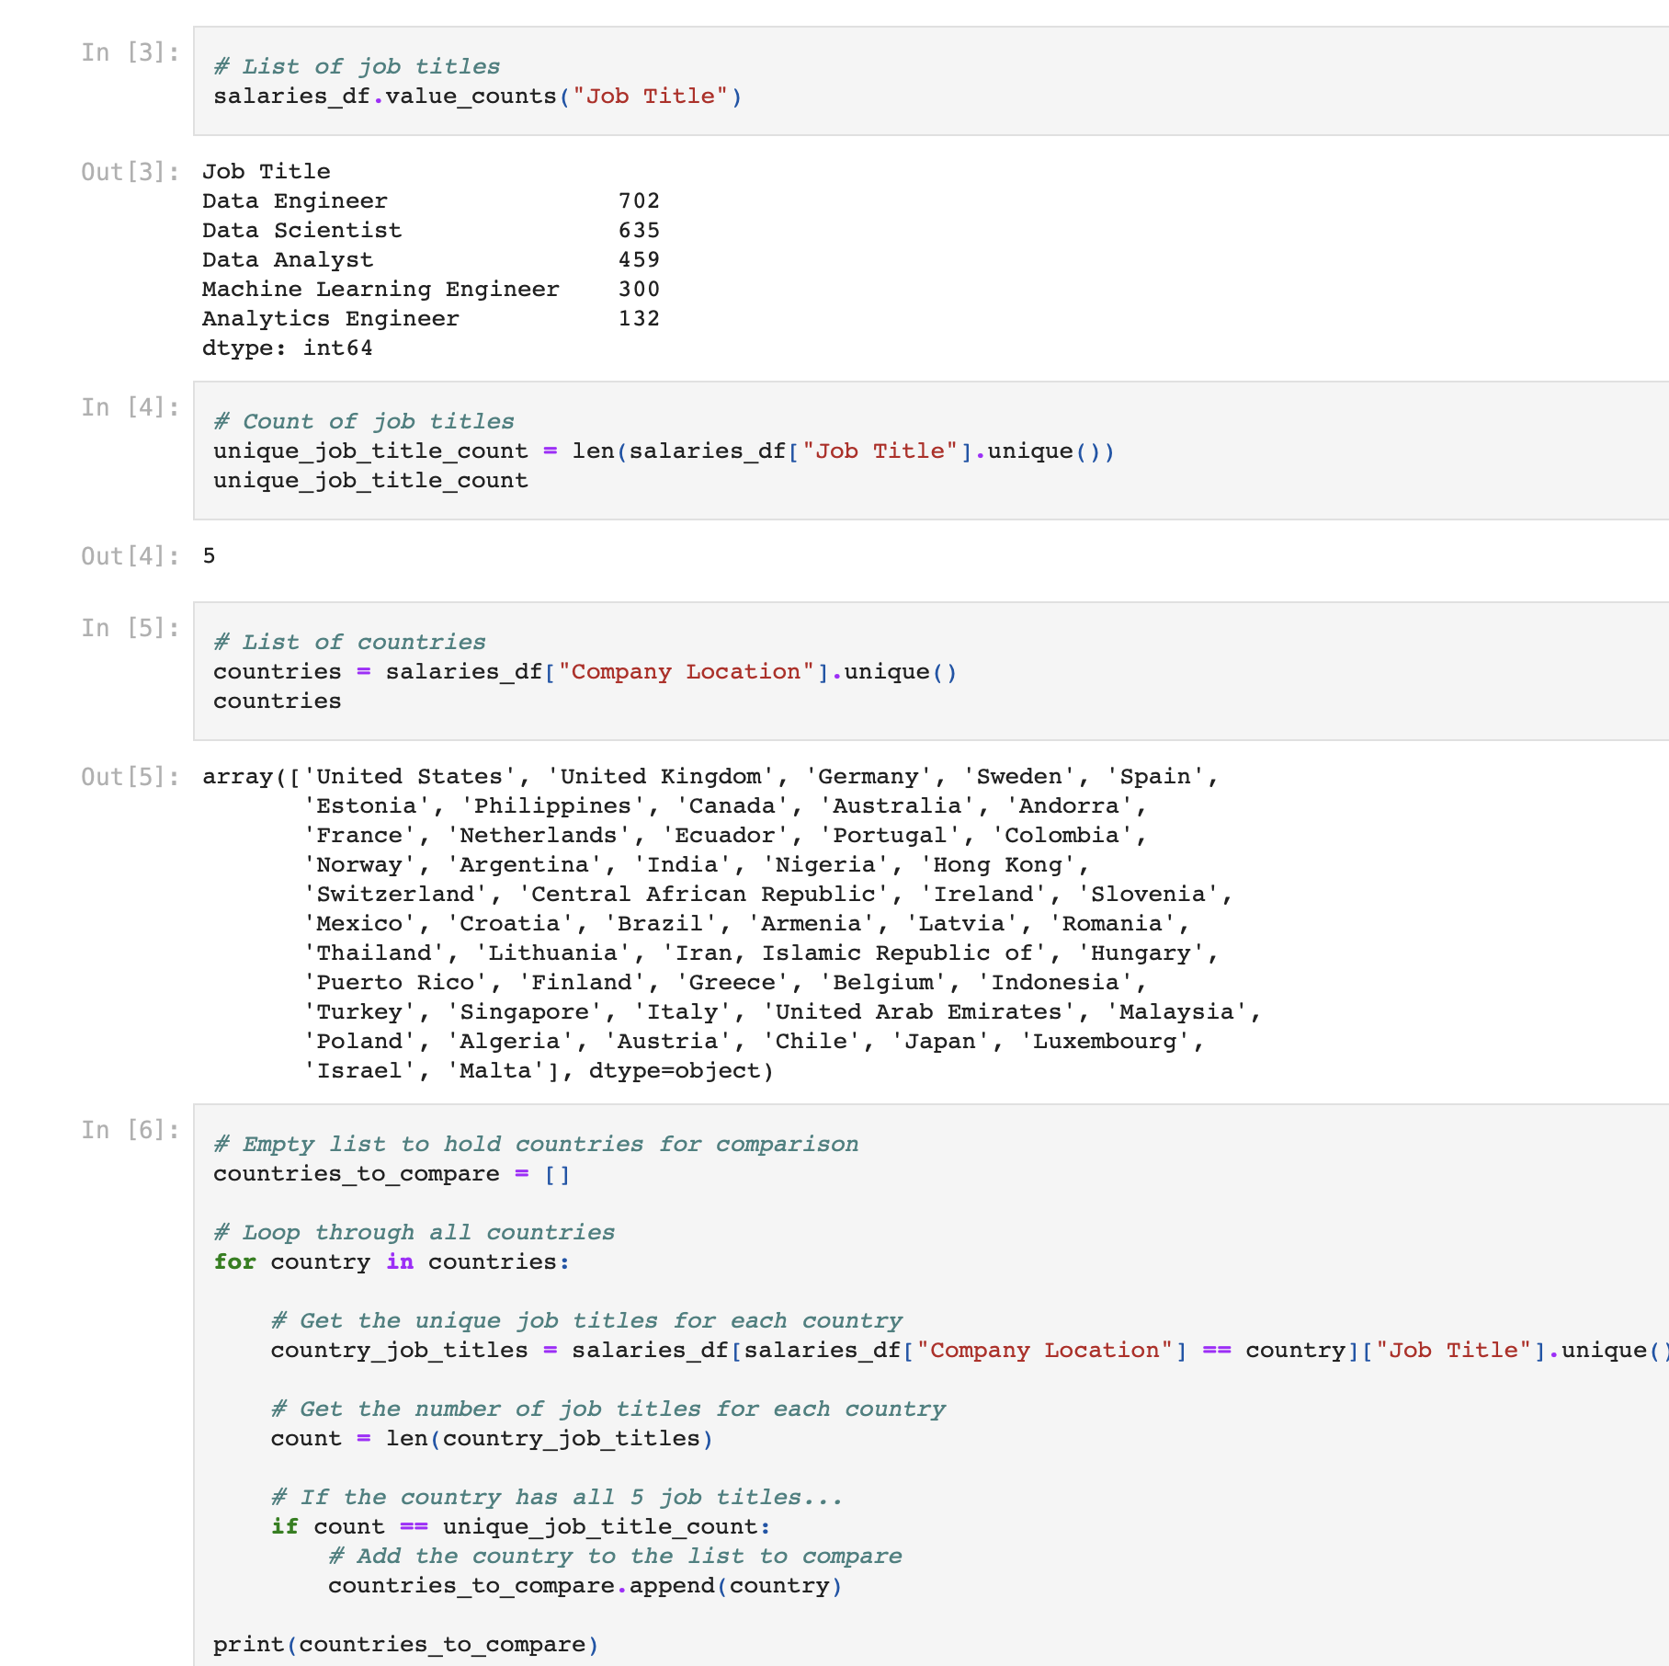
Jupyter Notebook Analysis
Validate job title and counts match clean data sets.
Create new data frames based on questions posed based on differences in salaries by title and country.
Create visuals based on data anal.
Explored job titles vs experience levels in order to gain best insights on next steps.
Final data cleaning resulted in moving forward with job titles with all experience levels included to better understand salary trends.

Slide 5

Questions
What are the differences in salaries between job titles under the data science umbrella?
Do we notice a higher demand or payout for certain positions in different countries?
What is the wage gap between experience/expertise levels?
Does company size have an impact on salary?
Can we predict salary outlooks for the future?

Slide 6
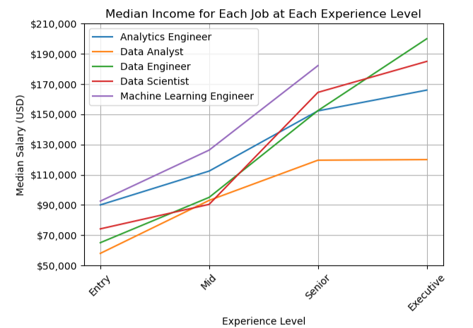
Median Income across Experience Levels
Salary Growth Rate from Entry to Executive
1. Data Engineer: 207.69%
2. Data Scientist: 149.52%
3. Data Analyst: 107.18%
4. Machine Learning Engineer: 96.97%
5. Analytics Engineer: 84.44%

Slide 7
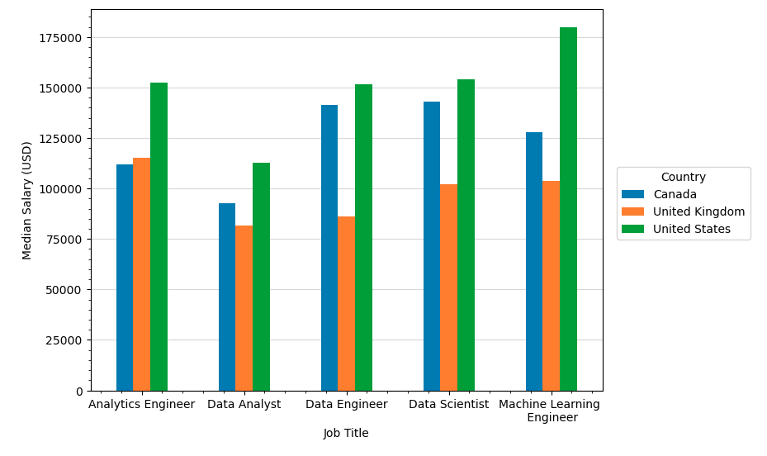
Median Income by Country for top Job Titles
We can see that United States has higher salaries across the board.

Slide 8
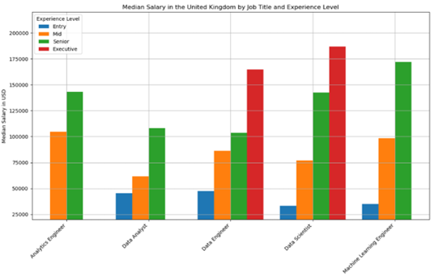
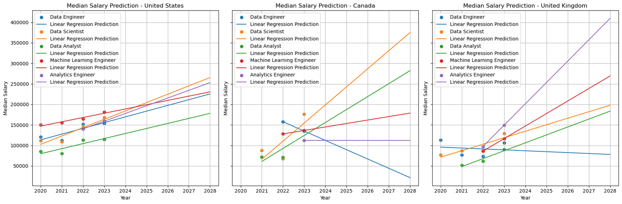
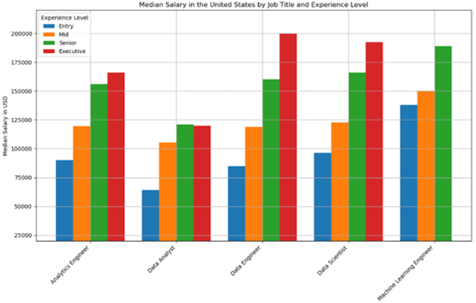
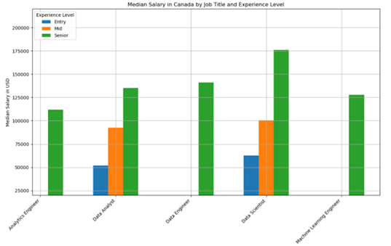
Experience Level Median Salary by Country
United States is the highest paid country followed by Canada and the United Kingdom
Only twice was the United States not he highest paid country
Only twice was the United Kingdom not he lowest paid country
55% the time the data supported our original conclusion
Notes:
Analytics Engineer in Canada only have data for 1 year (2023)

Slide 9
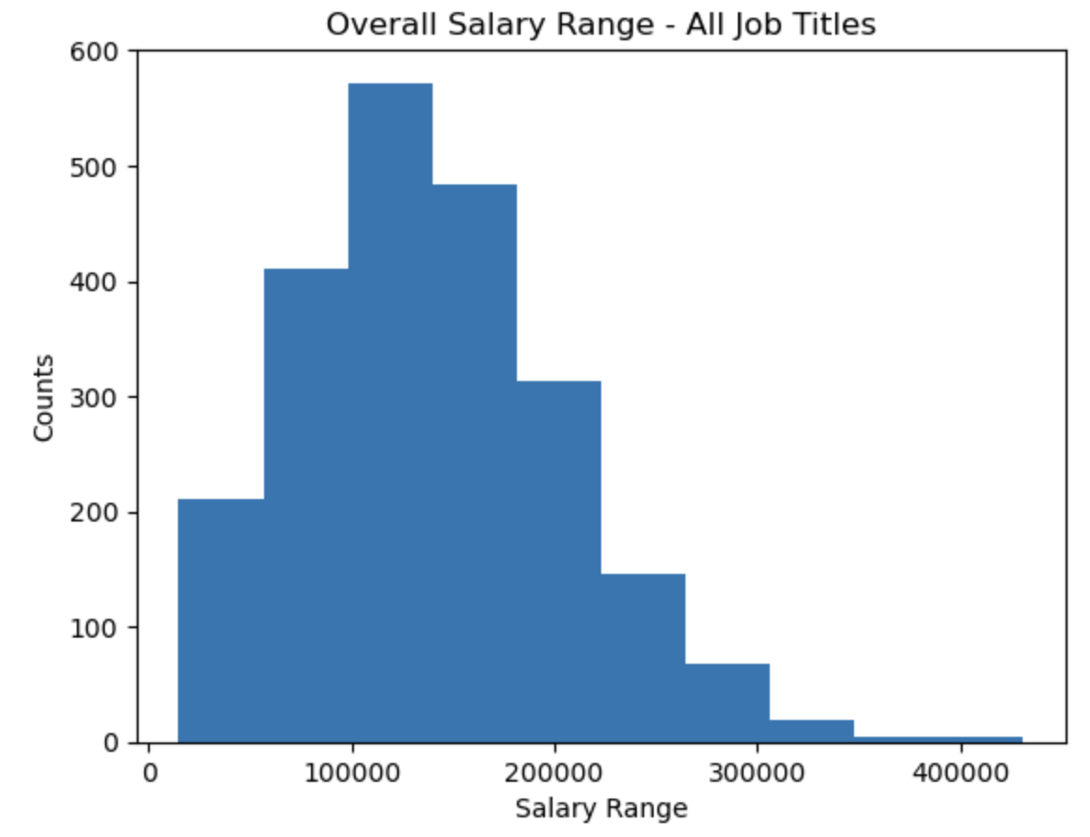
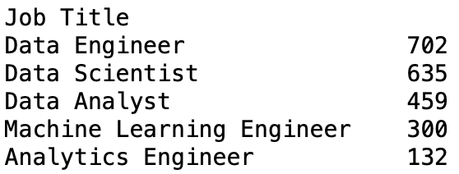
Overall, Salary Range with employees per job breakdown.

Slide 10
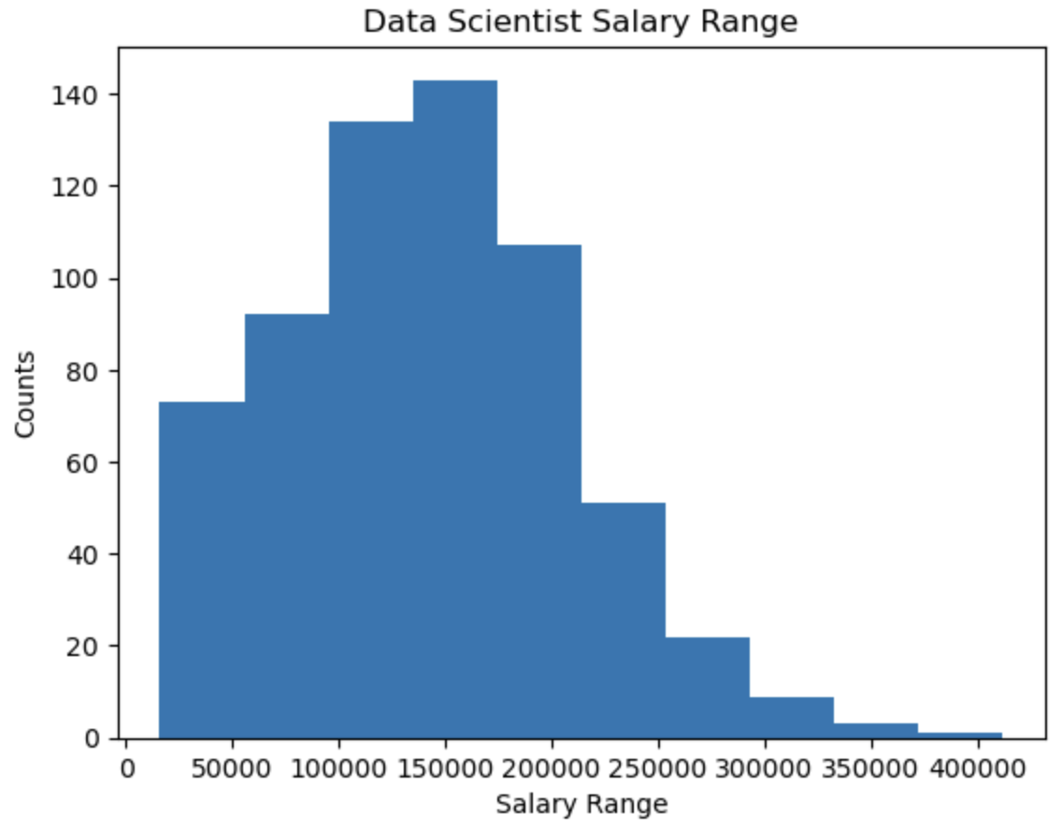
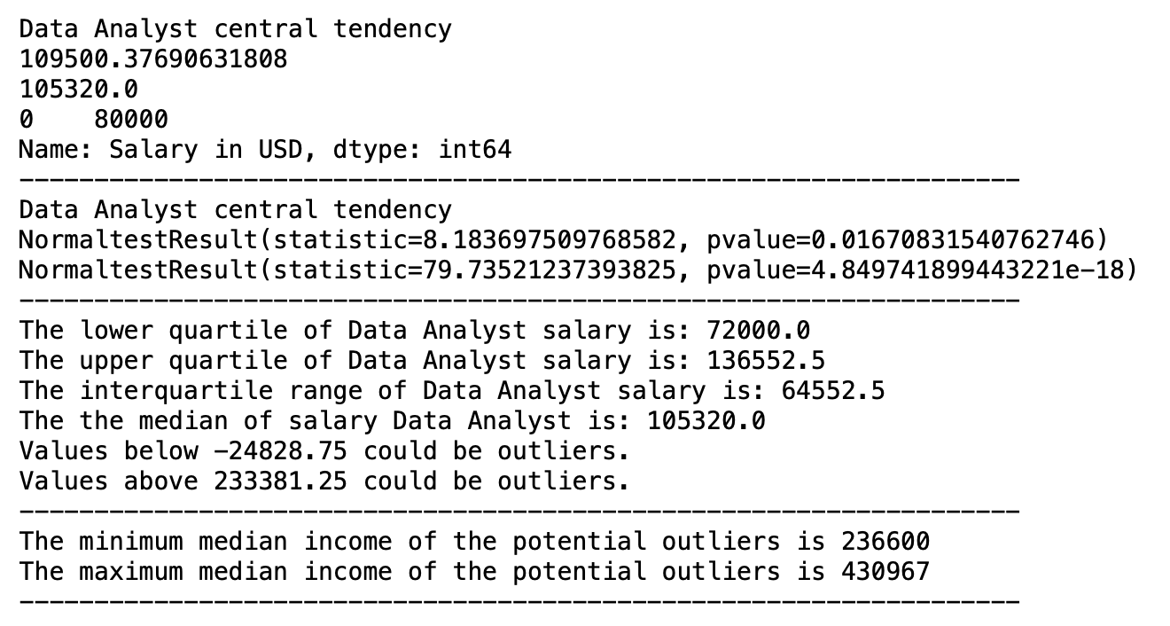
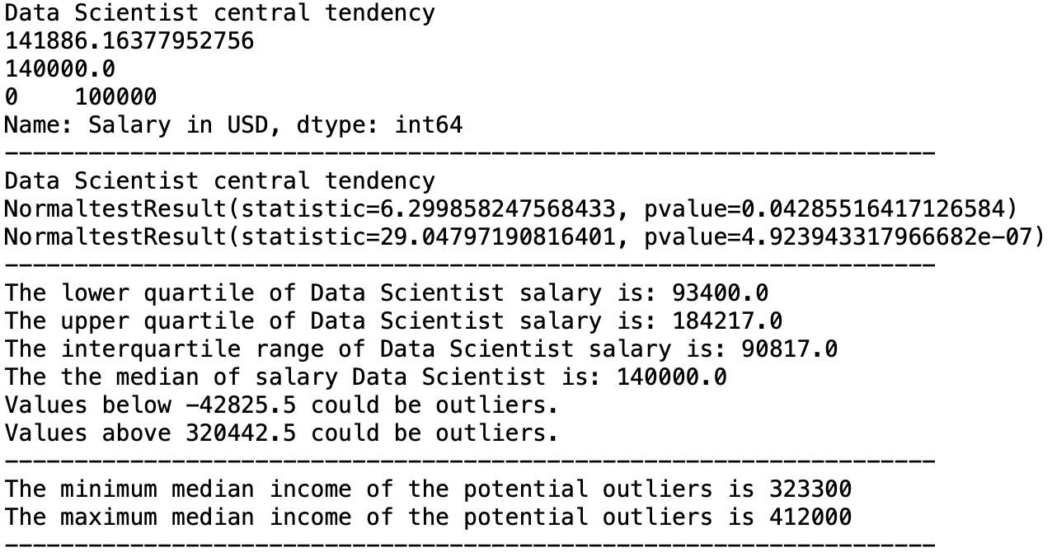
Data Scientist Salary Summary

Slide 11
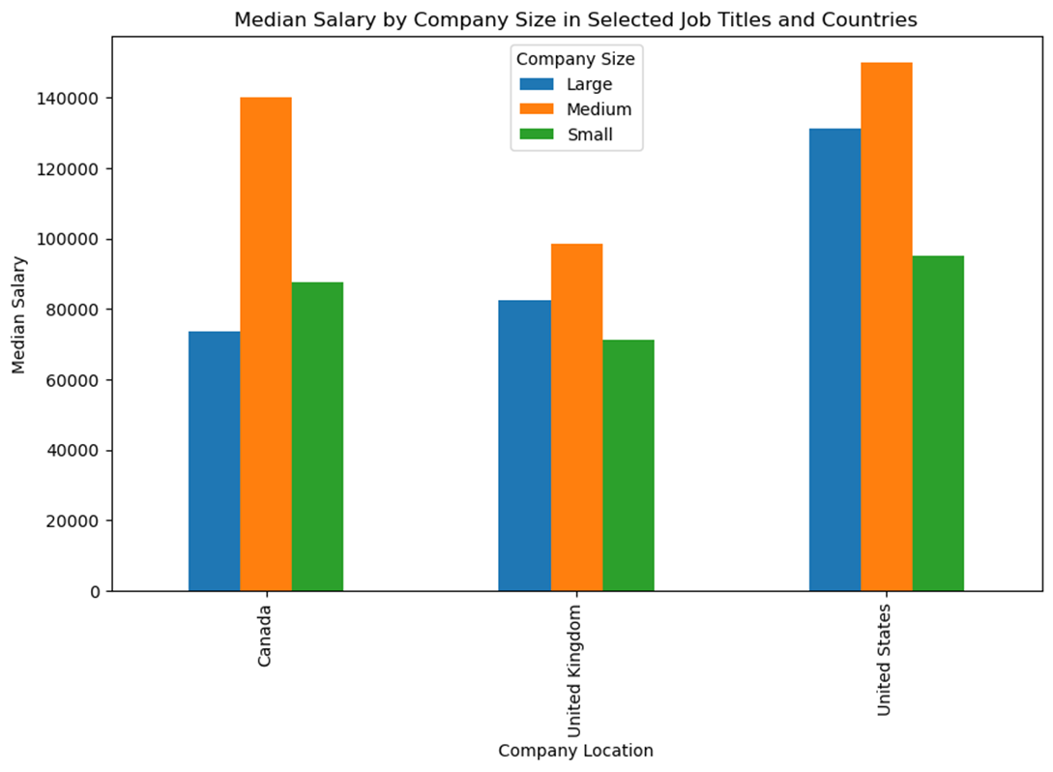
Median Salary by Company Size Analytics Engineer, Data Analyst, Data Engineer, Data Scientist, Machine Learning Engineer
Canada
Large: 73k
Medium: 140k
Small: 87k
United Kingdom
Large: 85k
Medium: 98k
Small: 71k
United States
Large: 131k
Medium: 150k
Small: 95k
Notes:
Medium sized companies have a higher salary in all 3 countries. Out of all the countries listed, the US medium sized companies have a greater pay. Large companies in Canada have the least pay in comparison to the large and medium sized companies. They also have the least pay in general, out of all three countries.

Slide 12
Median Salary Prediction
Most job titles have an increase in salary predictions.
Data Engineer in Canada & U.K. have a decrease in salary predictions.
Analytics Engineer in Canada did not have enough data for a salary prediction.
Notes:
Analytics Engineer in Canada only have data for 1 year (2023)

Slide 13
Final Thoughts
What are the differences in salaries between job titles under the data science umbrella?
The differences we found in salaries between job titles under the data science umbrella. For example, salary at different levels of expertise in their position, with some going as high as the director role and others to the expert level. Not to mention, between certain positions, you'll see a much higher percent increase in salary compared to others. For example, comparing the average salary of a junior data analyst to a intermediate goes from about $65,000 to $100,000 with about a 1.53x increase while a data scientist making the same expertise progression would on average only see about a 1.26x increase going from about $75,000 to $95,000.
What is the wage gap between experience/expertise levels?
Going from a certain experience/expertise level to another comes with a major increase for just about all job positions, although some being much more drastic than others. On average, for a position going from the junior level to the intermediate level in expertise levels, all jobs averaged a wage increase of about 1.36x what they had previously made in the junior level of the position. Judging from the overall lowest to highest level between job levels, the average increase in salary comes out to about 2.12x their starting salary at the junior level.
Does company size have an impact on salary?
Judging from the dataset, the only conclusion based on company size that can be made is smaller companies are tending to have a lesser salary poayout than the medium or large companies. Apart from that inference, any company for any position tends to have salaries at many different levels leading us to believe that the company size does not have an impact on an employees salary.
Can we predict salary outlooks for the future?
Using the dataset, we are indeed able to predict a salary outlook for the future, although, calculating how a salary would taper off would prove to be very difficult, predicting within a reasonable time from being around the next year or two would seem to be a bit more predictable. Although, in using a regression line to predict the future outlooks, one would see that the salaries would rise over time all around, no matter the job title.

Slide 14
Appendix

Slide 15
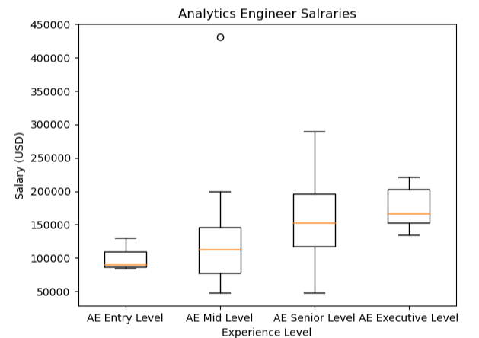
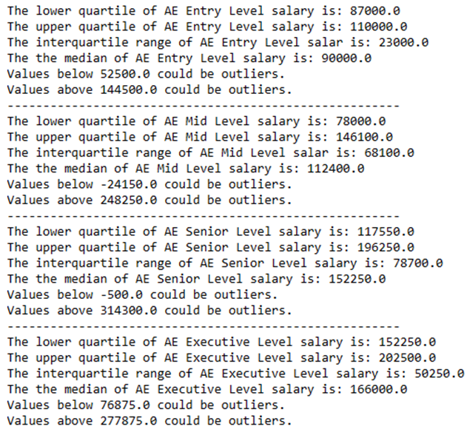
Analytics Engineer Salary Boxplot

Slide 16
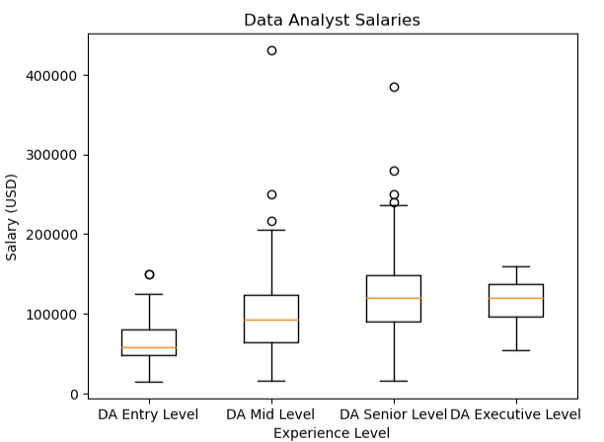
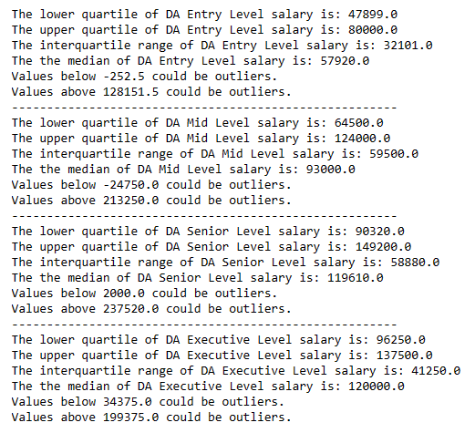
Data Analyst Salary Boxplot

Slide 17
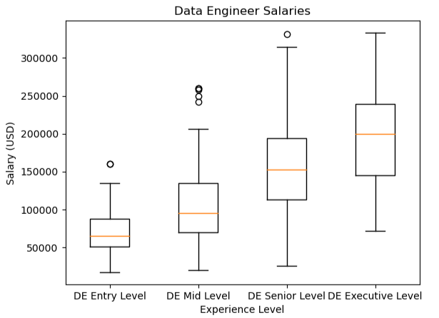
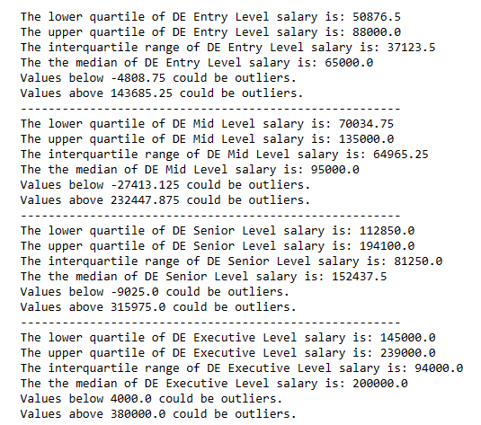
Data Engineer Salary Boxplot

Slide 18
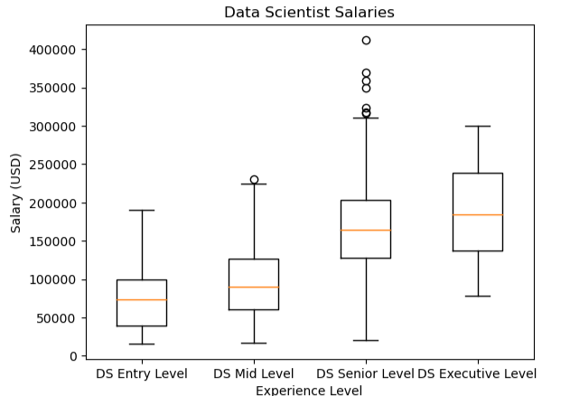
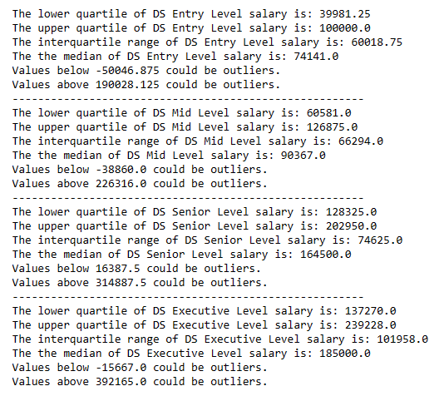
Data Scientist Salary Boxplot

Slide 19
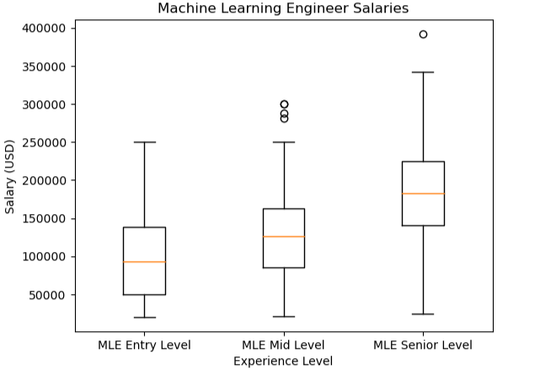
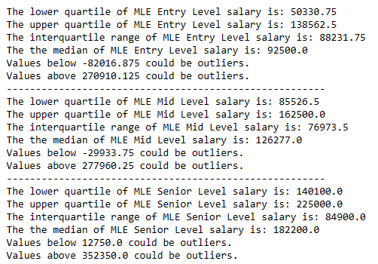
Machine Learning Engineer Salary Boxplot

Slide 20
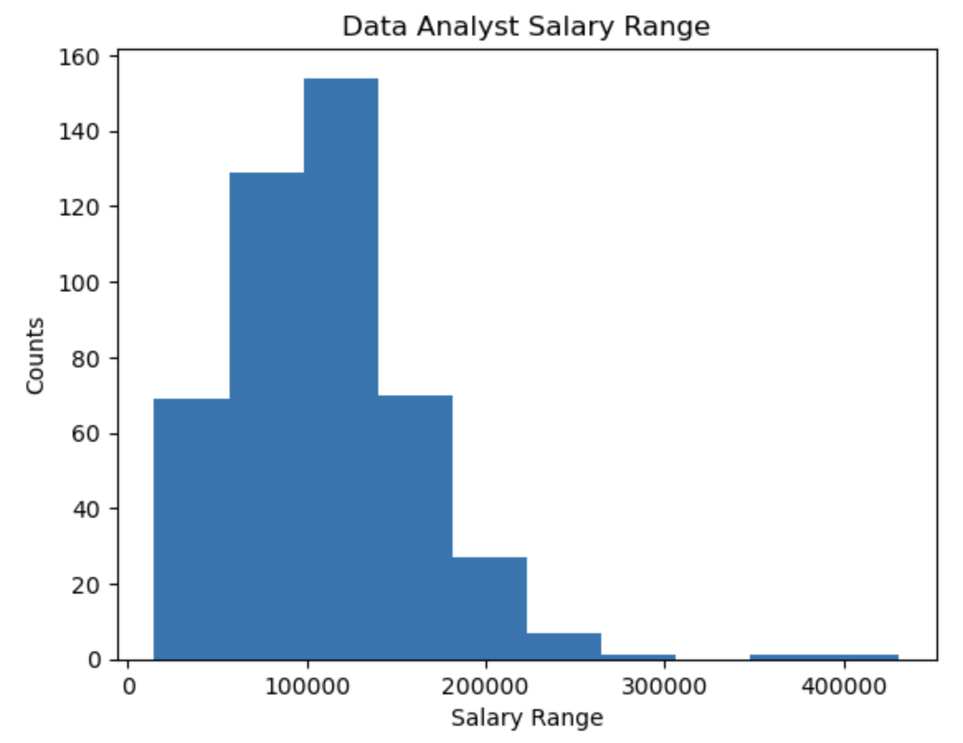
Data Analyst Salary Summary

Slide 21
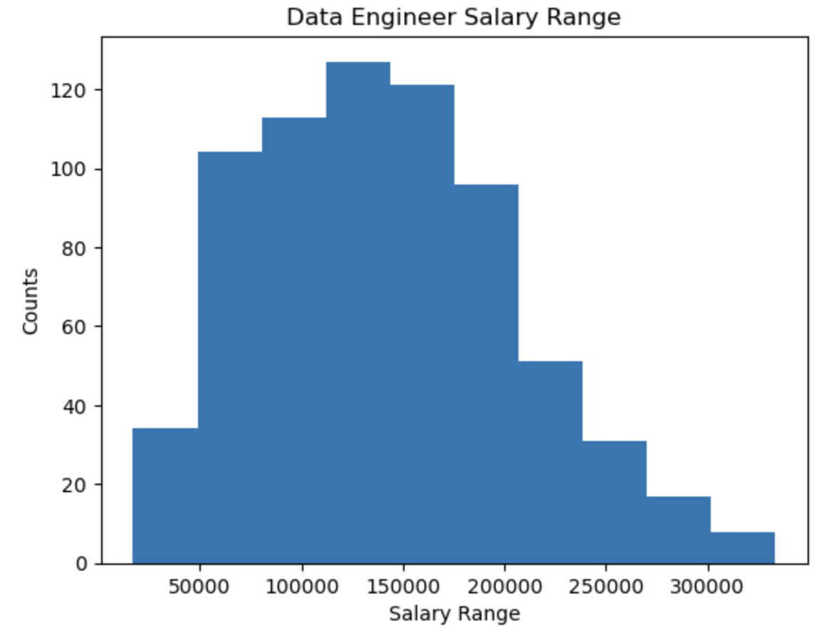
Data Engineer Salary Summary

Slide 22
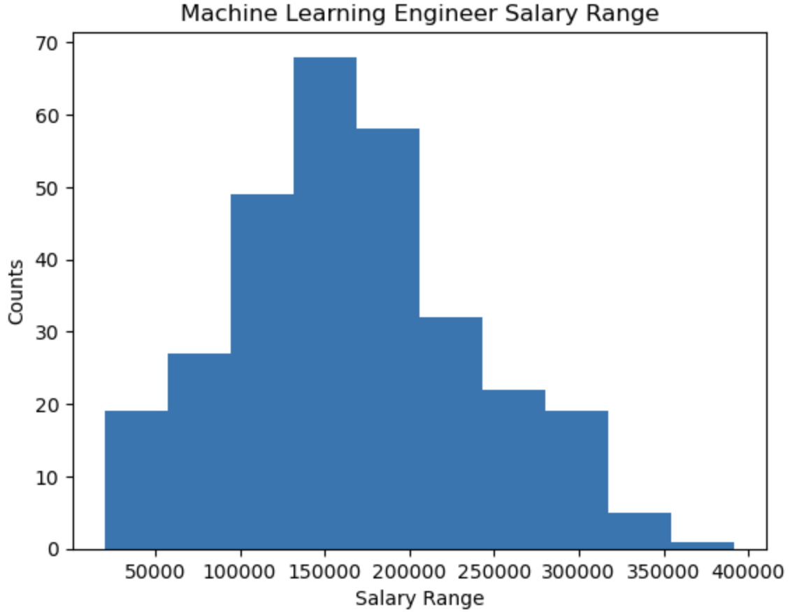
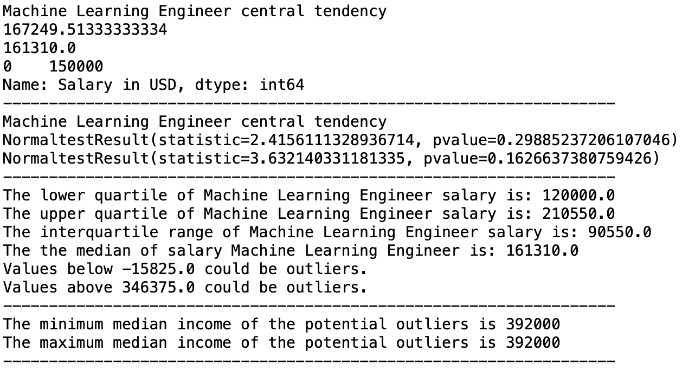
Machine Learning Engineer Salary Summary

Slide 23
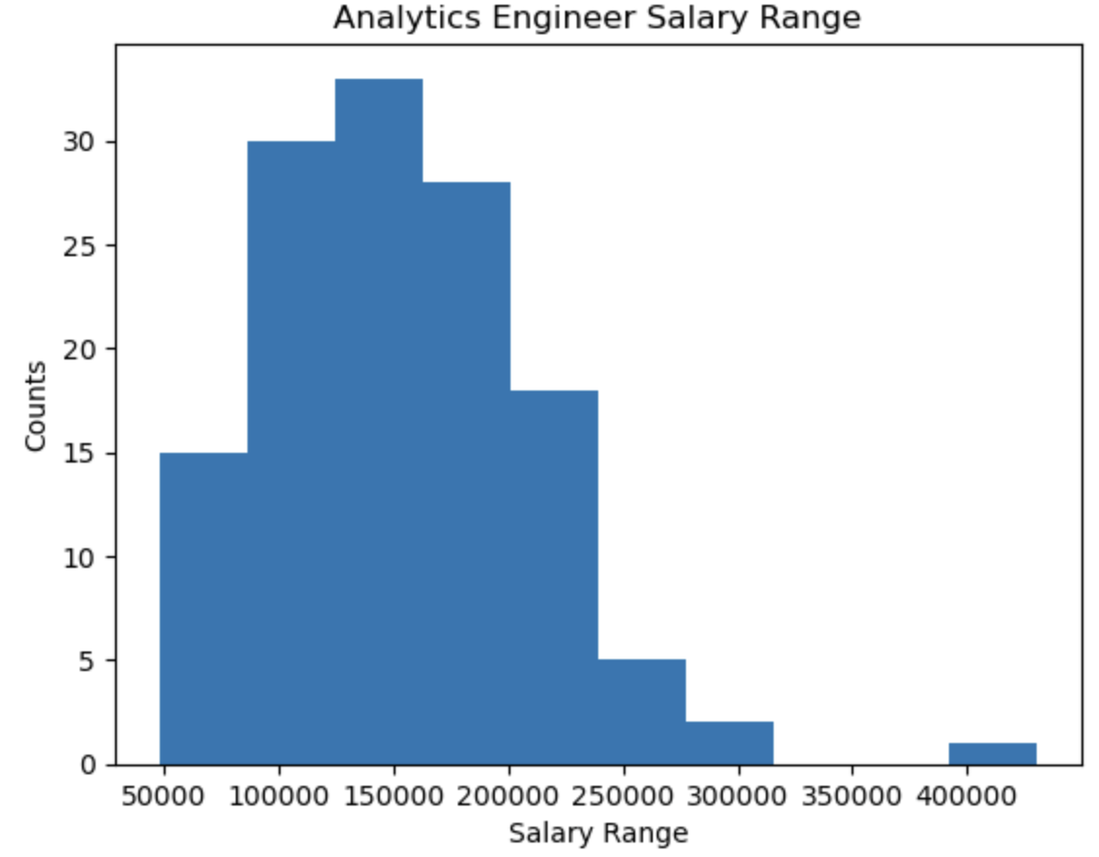
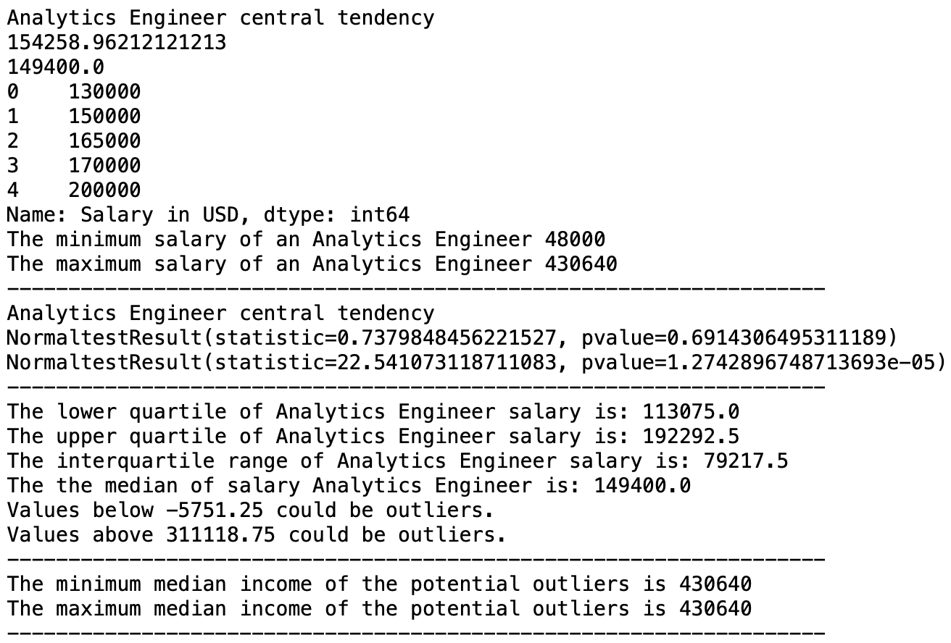
Analytics Engineer Salary Summary

